Slide 1
FINANCIAL DASHBOARD 2.0
Sponsored by SIMPLY-BI
Team:
Aditya Bhandari
Akshat Verma
Mallika Trakanpasakul
Prakher Gupta
Project Manager:
Mr. Renaud Viot
Academic Advisor(s):
Professor Kyle D. Cheek
Professor Ali Tafti
Ramah Al Balawi (Teaching Assistant)

Slide 2
Sponsor: SIMPLY - BI
Simply BI is a BI Platform idealized by Mr. Renaud Viot, who also serves as the Head of the Data Science Team at AXA Partners.
Simply BI will serve as a consulting partner dedicated to providing business intelligence to companies.
Simply BI is focused on producing end to end approach to allow its clients to be fully engaged and independent in regards with their data tools. Those tools vary from simple KPI trackers, to deep learning fraud detection tools and much more.

Slide 3
Problem Statement
Many portfolio managers uses BI tools for making crucial decisions on behalf of their investors, most of these tools are just simple dashboards showing basic figures/KPI’s, but not the in-depth research and analysis of how they can generate better returns using that information.
Simply BI will enable the investors to use our research platform which is equipped with both financial statements analysis and market research using sentiment analysis on Text data like blogs, tweets, and RSS feeds etc..
It will allow investors to figure out how each company in their existing portfolios is performing as compared to other publicly traded companies in the sector, also which company to keep/add/remove.

Slide 4
Overview
Objective: Portfolio managed right. What does this mean?
Business justification: Many tools available for portfolio management based on prediction of various metrices. Then how is this different?
Final Product: Intelligent Platform which would show ideal companies to be added into the portfolio with maximized profits based on valuable Modeled KPIs.
As a result of this capstone, we will provide an additional layer to those business intelligence tools for companies to get tangible added value to their analysis

Slide 5
Data Requirements:
We were provided with an option of selecting a specific business sector from the Aviation, Construction, and the Auto industry.
We decided to move ahead with automobile because of the high volatility of the sector.
The data of all the 18 publicly traded automobile companies in the US is available on the SECs (Security Exchange Commission) website.
These companies comprises of:
Automobile Manufacturers,
Automobile Retailers,
Auto Part Stores,
Boating,
Commercial and Specialty Vehicles,
Tires

Slide 6
Data Management
Acquisition: We have scraped the annual financial statements i.e. 10-K/20-F(non US) from the SECs website, read the balance sheets and Profit-Loss statements for each company starting from 2009 till 2017.
Transformation:
Separated both datasets individually for each company by Income Statements and Balance Sheets.
We have conceptualized harmonization elements to group important metrices for each company, to use them as important variables in modeling the KPIs later.
We will use Python to do modelling and other abstract transformation.
Storing:
We stored the transformed datasets in Azure MySQL DB.
All the modelled output and generated KPI data will also be stored in a separate output table in the same Database.

Slide 7
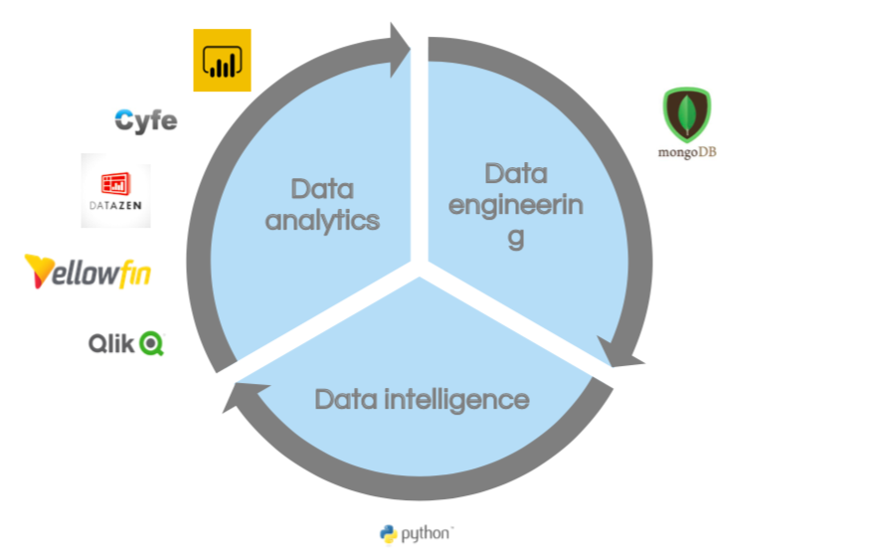

Our Value Creation:
The intelligent layer which would use text analytics to determine events of past..
This is where we want to operate
Type to enter a caption.

Slide 8
Resource Requirements:
DATA:
Financial Statements (10-k/20-F)
Text Data Supporting abrupt changes: Blogs, Tweets, RSS feeds etc.
Tools:
MS-Excel,
Jupyter Notebooks or any IDE with Python 3.0+ support,
Azure MySQL instance.
BI Tools: Tableau, Power BI, Qlik View, Yellowfin, Cyfe, and Datazen etc.
Time: We expect to deliver the project by third week of November. More detailed deliverable timeline is given in the GANTT Chart.

Slide 9
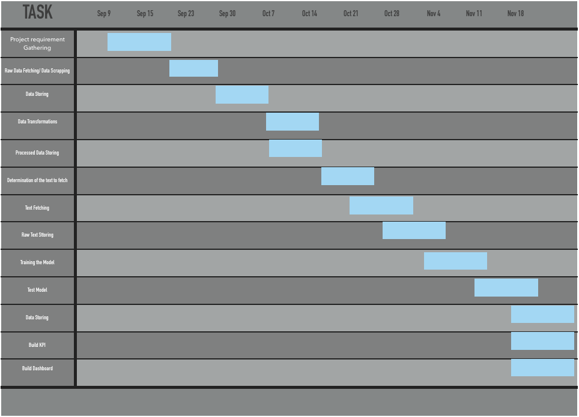
Project Deliverable(s) Timeline

Slide 10

Milestones Condensed
Milestone | Description | Date
Complete Requirements Gathering | All requirements for the Project must be determined to base design upon | 09/21/18
Complete Data Acquisition and Preparation | Data Pipelines and ETL procedures to be stored for automatic data fetching, cleaning, and storing | 11/02/18
Complete Modeling and Testing | Fine tuning of models used in data analysis with development code and configurations | 11/16/18
Complete Model Deployment and Handoff | Completed software and documentation transitioned to operations group to begin production | 11/26/18

Slide 11
Key Risks:
Data level:
Not Enough Data
Since SEC does not have a strict restrictions on how a company handles their balance sheets or income statements, every company has different elements.
Project level:
Our analysis is based upon the behavior and the market movement of a company in the past. Risk???
Highly unpredictable behavior. For e.g. TESLA

Slide 12
Risk Register:
# | Risk | Description | Category | Cause | Probability | Impact | Proposed Responses | Owner | Status
1. | DB Change | MongoDB complexity to store tabular data | Data Preparation | Data Fetching and Storing | 0.9 | Critical | Move to Azure MySQL | Renaud | Closed
2. | Data Volume | Only 9 statements/company | Modeling | Annual data | 0.4 | Critical | Use Quarterly Data 10-Qs | Renaud | Open
3. | Fields Inconsistency | Inconsistent field names across the companies | Data Gathering | Unique Statements and non US companies | 0.9 | Moderate | Identify and put them in subgroups | MallikaAditya Prakher Akshat | Closed

Slide 13
Deployment:
Once the modelled KPIs are tested and proved to be of value, we will create an additional intelligence layer between the BI tools and the databases.
This will extract the insight required from previously transformed and stored data to run through our feature extraction and machine learning models.
Results will be added as additional vital information in existing dashboards. This will also become our business offering in future as a premium service.
This can be done by creating new widgets or modifying previous KPIs.

Slide 14
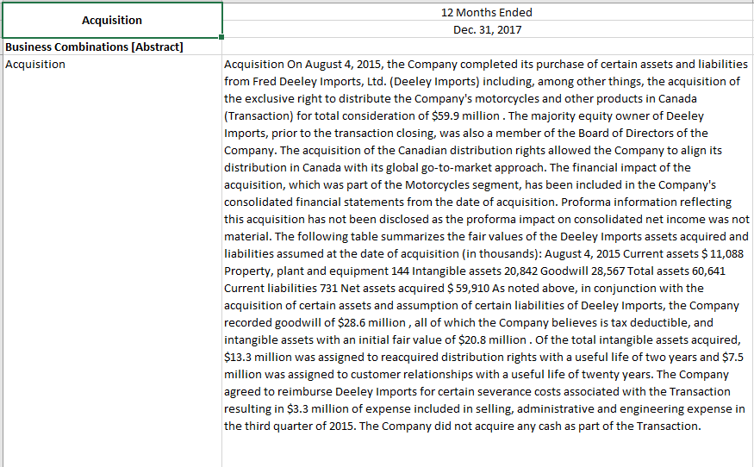
Sample Metric
We try and forecast the revenue based on the assets and liabilities using simple time series models
Meanwhile, company X releases an acquisition report, as shown. (Also, present in the SEC report file for the company)
How will this affect the revenue? Good or bad?
If the acquisition in the past resulted in a bearish stock price, do you want to re-consider?
Oh, an acquisition?

Slide 15
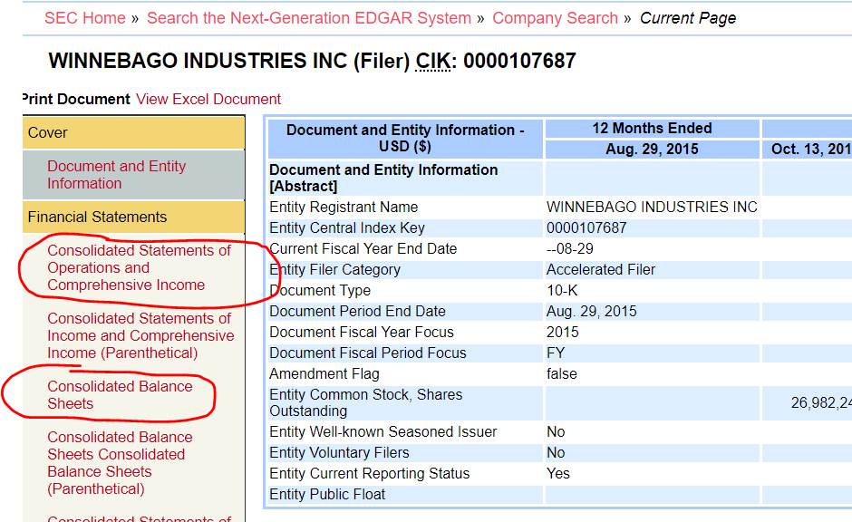
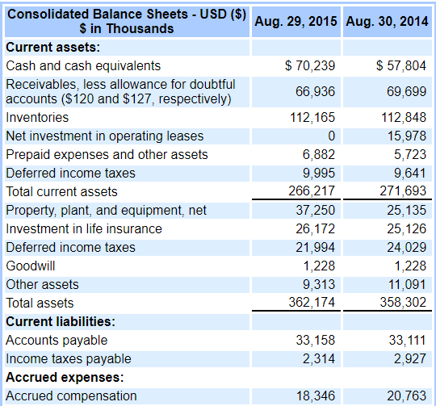
Important Links:
Data Sources:
Every publicly traded company has to submit a quarterly/annual report to SEC containing the balance sheets and profit and loss statements
http://investsnips.com/complete-list-of-vehicle-manufacturers-and-suppliers-listed-on-u-s-exchanges/
https://sec.gov/edgar/searchedgar/companysearch.html

Slide 16
Thank You For Listening

